Slide 1

Project ERDOS
Towards End-to-End Compute Graph Optimization with Graph Neural Networks
Team:
Mohd Tabish Jamal
Nazar Iqbal
Rijin Shaji
Oishi Chatterjee
Raja Shekar Dubaguntla
Sathya Sudha Murugan
Presenter:
Mohd Tabish Jamal
Mentor
Gabriel Campero Durand

Slide 2
Agenda
Motivation
Project Goals
Prototype Design
Tentative Timelines
Team Introduction
Paper Structure

Slide 3
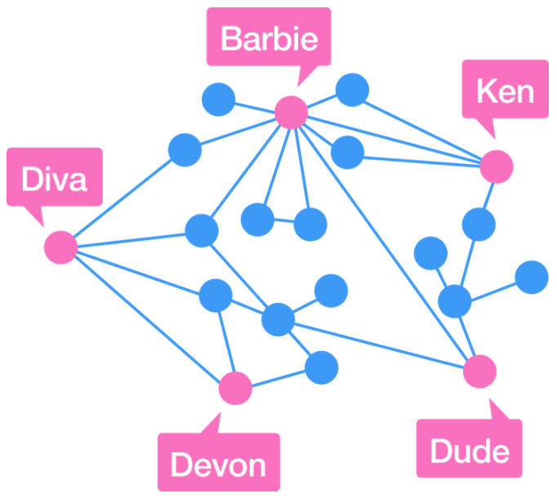
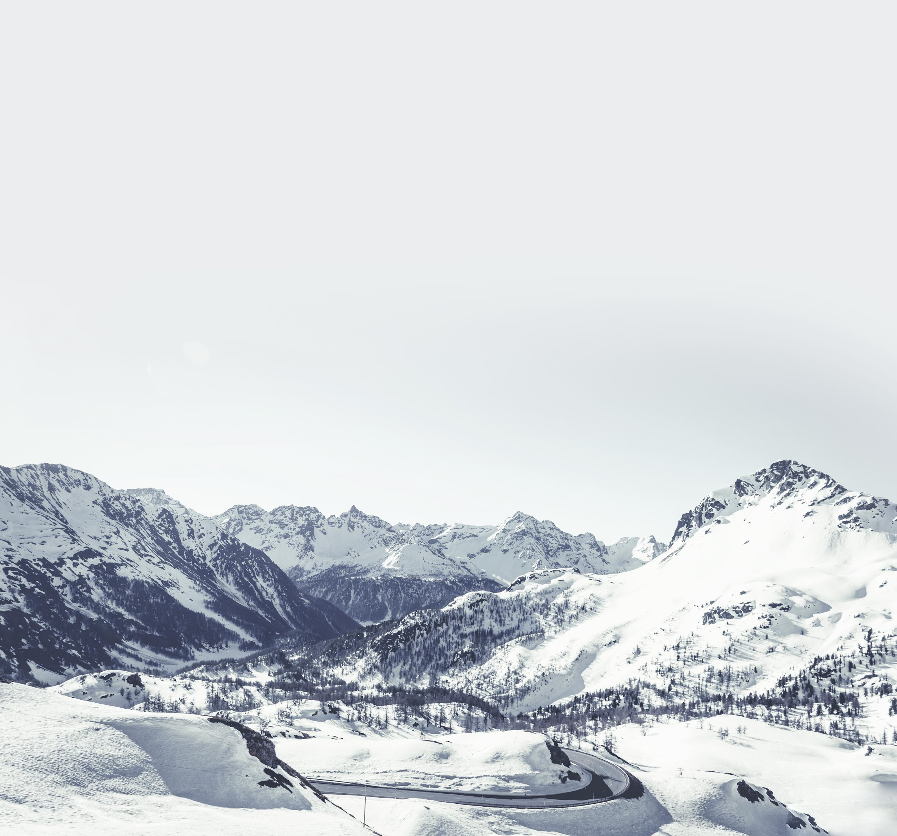
Motivation
Graph is a data structure that is defined by two components
Nodes/Vertex: Objects that are connected together
Edges: Connection between the two nodes
Graphs can be Directed or Undirected
Graph theory is used widely in programs and applications:
Maps: Find shortest path for destination
Social Network: Friends and Mutual friends
Computation Graph: Flow of Computation
https://brilliant.org/problems/friends-of-friends/

Slide 4
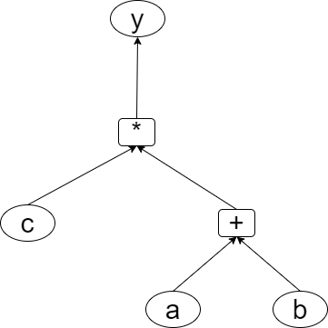
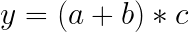
Motivation - Computational Graphs
Computation Graph is the way of expressing and evaluating an expression
We are surrounded by programs and all programs are transformed into a Computational Graph to be executed
Machine Learning and Database operations are also expressed as compute graphs

Slide 5
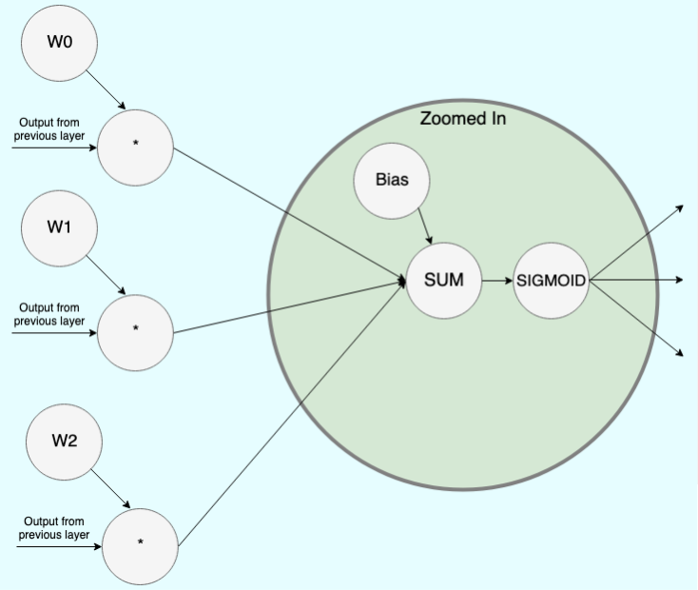
Motivation - Device Placement[6]
Many applications use large Machine Learning / Neural Network models which has high computational requirements
To run the model optimally, the compiler places the nodes in ML accelerator(GPUs /TPUs)[Zhou20]
ML compilers map High-Level computational graph operations on these accelerators
https://medium.com/tebs-lab/deep-neural-networks-as-computational-graphs-867fcaa56c9

Slide 6
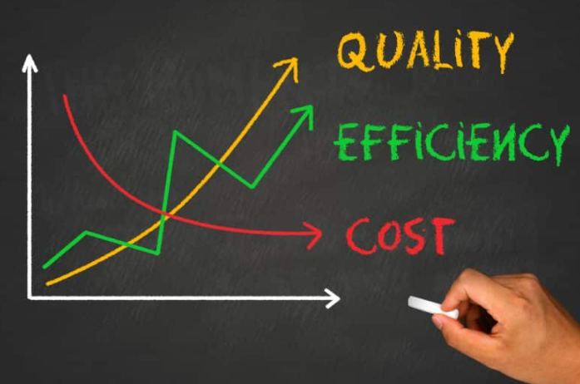
Motivation - ML Compiler Optimization[6]
Existing learning based approaches are sample inefficient, tackle a single optimization problem, and do not generalize to unseen graphs making them in feasible to be deployed in practice
ML compilers need to solve many optimization problems including Node-to-Device Placement, Operation Scheduling, and Operation Fusion
ML compilers usually apply heuristics for optimization
Lead to sub-optimal configuration
by solving optimization problems in isolation, the compiler misses out on opportunities for joint optimizations across tasks
[Zhou] has proposed an end-to-end, transferable deep reinforcement learning method for computational graph optimization
33%-60% speedup on three graph optimization tasks compared to TensorFlow default optimization[6]
https://www.cloudsigma.com/how-cost-optimization-with-the-cloud-impacts-services-and-application-architecture/

Slide 7
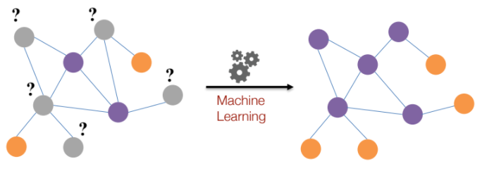
Motivation - ML in Graphs
Machine Learning tasks on Graphs[3]:
Node Classification
Link Prediction
Clustering and Community Detection
Graph Classification, Regression, and Clustering
https://drive.google.com/file/d/1By3udbOt10moIcSEgUQ0TR9twQX9Aq0G/view

Slide 8
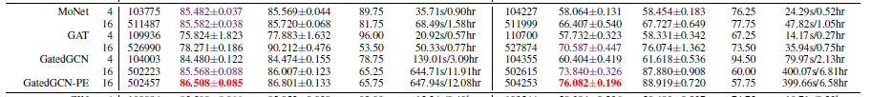
Motivation - Device Placement as Node Classification and Best Model[5]
Datasets used: PATTERN and CLUSTER
The best Node classification has been observed by [Dwivedi20] is in GatedGCN-PE* models
[Dwivedi20] Models with the suffix -PE use Laplacian Eigenvectors as node positional encodings, with dimension 2 for PATTERN and 20 for CLUSTER

Slide 9
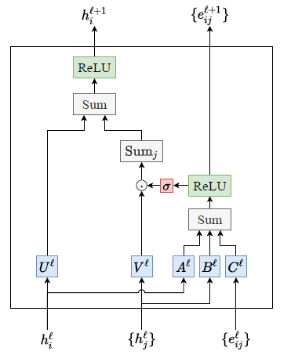
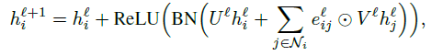
Motivation - GatedGCN[5]
Different from other anisotropic GNNs, the GatedGCN architecture explicitly maintains edge features at each layer
[Dwivedi20]

Slide 10

Project Goals
RQ 1: To what extent does the performance of models(MoNet, GAT, GatedGCN, and GatedGCN-PE) improve by changing the Parameter Configuration on traditional Node Classification Datasets such as Pattern and Cluster.
The model which comes out to be best in RQ1 would be considered further for RQ2.
http://www.personal.psu.edu/bxb11/Objectives/
RQ 2: To what extent does the performance of these models(MoNet, GAT, GatedGCN, and GatedGCN-PE) improve the Classification task on Dataset of Machine Learning Computation Graphs for Device Placement.
The model which comes out to be the best in RQ2, would be considered for future work with Deep Reinforcement Learning.
Long term Goal: Optimize the Databases with Deep Reinforcement Learning that uses Graph Neural Network.

Slide 11
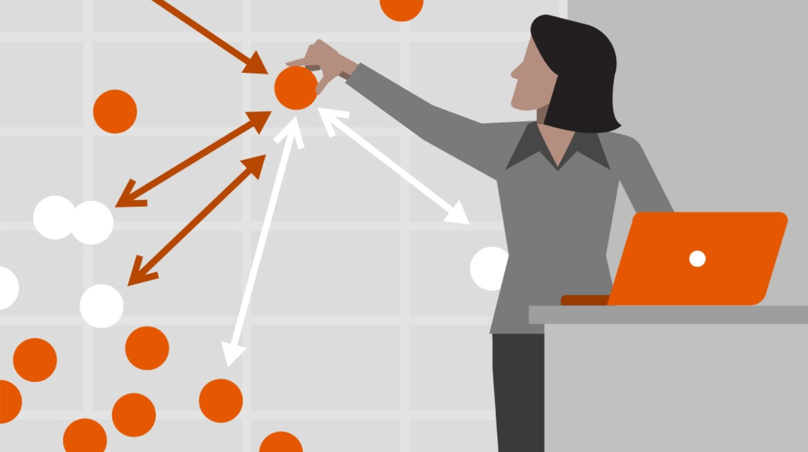
Prototype Design
Graph NN will be trained for Node-classification task by using the dataset containing ML Models for Device Placement
Step 3
Models(MoNet, GAT, GatedGCN, and GatedGCN-PE) will be trained by using PATTERN and CLUSTER dataset
They will be tuned to improve the performance
Step 2
https://cdn.lynda.com/course/645048/645048-637356859282285031-16x9.jpg
Step 1
Machine learning Models are generated by using PyTorch or Tensorflow
Models will be exported in JSON files

Slide 12
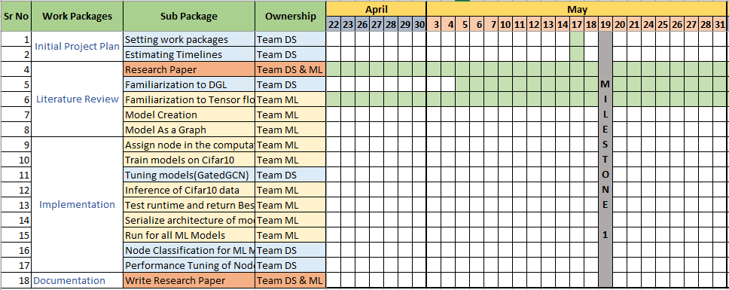
Tentative Timelines

Slide 13
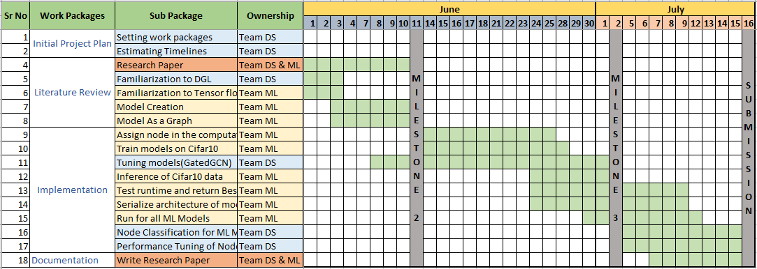
Tentative Timelines

Slide 14

Teams
The project is handled by two sub-teams
Team Machine Learning: Incharge of Generating Datasets
Team Data Science: Incharge of optimizing Graph Neural Networks
https://blog.vantagecircle.com/teamwork-and-team-building/

Slide 15

Paper Structure
Introduction
Background
Device Placement
Graph Neural Networks
Prototype Design
Research Questions
Work flow/ Data flow
Evaluation metrics
Experiment Setup
Datasets
Hyper parameters
Softwares/Libraries
Evaluation
Node Classification
Device Placement
Conclusion and Future Work
https://www.theijbm.com/tips-on-effective-use-of-tables-and-figures-in-a-research-paper/

Slide 16
References
https://latex.codecogs.com/eqneditor/editor.php
https://app.diagrams.net/
Graph Representation Learning Book by Hamilton, William L.
Slides on Graph Representation Learning by Jure Leskovec (Stanford) https://drive.google.com/file/d/1By3udbOt10moIcSEgUQ0TR9twQX9Aq0G/view
Dwivedi, Vijay Prakash, Chaitanya K. Joshi, Thomas Laurent, Yoshua Bengio, and Xavier Bresson. "Benchmarking graph neural networks." arXiv preprint arXiv:2003.00982 (2020).
Zhou, Yanqi, Sudip Roy, Amirali Abdolrashidi, Daniel Wong, Peter Ma, Qiumin Xu, Hanxiao Liu et al. "Transferable graph optimizers for ml compilers." arXiv preprint arXiv:2010.12438 (2020).

Slide 17
Thank you.

